Slide 1
Java Variables and Literals

Slide 2
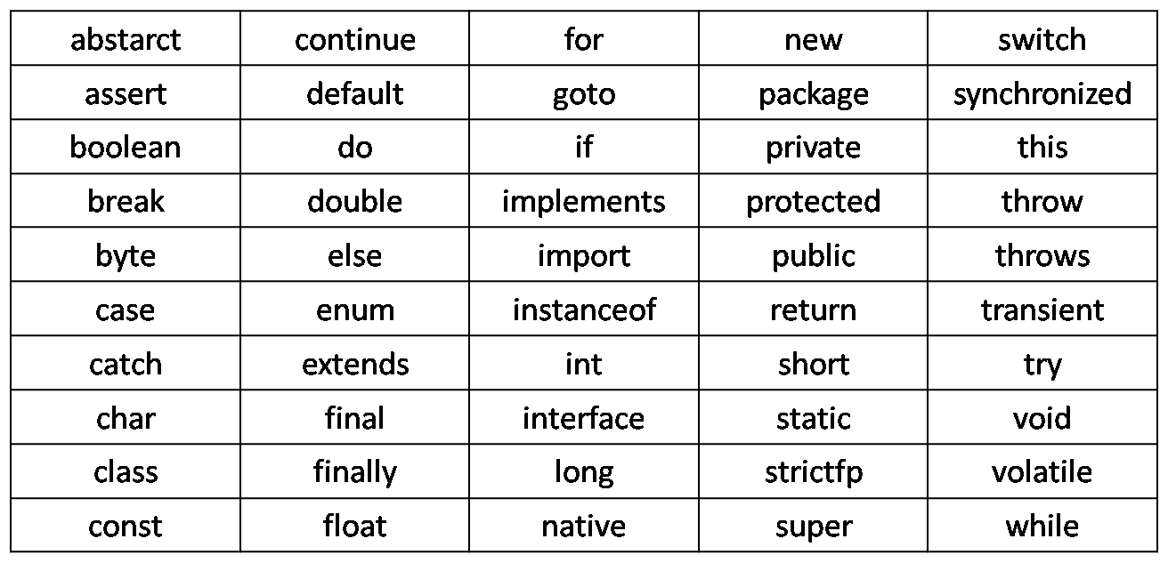
List of Keywords

Slide 3
keywords
Keywords are the predefined words which contain functionality
There are 50 number of keywords 3 reserved words which are the words which does not contain any functionality.
We can not use keywords as:
Names for variables
Methods
Classes or any identifier

Slide 4
Data Types
There are two types of datatypes in java:
Primitive datatypes
Non-primitive Datatypes

Slide 5
Primitive Datatypes
There are 8 types of datatypes as following:
1) boolean: the type whose values are either ‘true’ or ‘false’
Size is 1 bit only, range = true or false, default = false
2) byte:
size = 1 byte, range = -128 to 127, default=0
3) char: the character type whose values are 16-bit Unicode characters
Size = 2 Byte, range = one character or 0 to 65,536(unsigned), default=\u0000
4) short:
Size = 2 bytes, range = -32,768 to 37,767 , default = 0

Slide 6
5) int:
Size = 4 bytes, Range = -2,147,483,648 to 2,147,483,647, default = 0
6) float:
Size = 4 bytes, range = ± 3.40282347E+38F (6-7 significant decimal digits), default=0.0
7) long:
Size = 8 bytes, Range = ± 9,223,372,036,854,775,808, default = 0
8) double:
Size = 8 bytes, Range = approx. ± 1.79769313486231570E+308 (15 significant decimal digits.), default = 0.0

Slide 7
Variables
Variables are just like containers which hold the values while the program is executed.
A variable is a storage location paired with an associated symbolic name (an identifier), which contains some known or unknown quantity of information referred to as a value.
Variables in Java are strongly typed; thus they all must have a data type declared with their identifier.

Slide 8
Naming a Variable
Just as every person has a name to identify them, every variable has a name associated with it.
There are certain naming conventions that one must follow in order to decide a name for the variable. This name is called the variable’s identifier. Variable names should be descriptive based on what data item they are declared to store.

Slide 9
Rules to create an Identifier
Characters from A to Z, as well as their lowercase counterparts, can be used.
Numbers from 0-9 can be used.
Special characters that can be used are $ (the dollar sign) and _ (underscore).

Slide 10
example
// Example of variable
int age;
double salaryRequired;
boolean isEmployed;

Slide 11
These variables do not have any value associated with it
To assign value to the variable we use “=” assignment operator.
E.g.,
age = 25;
When code is used to represent a fixed value, like 25, it is referred as literals

Slide 12
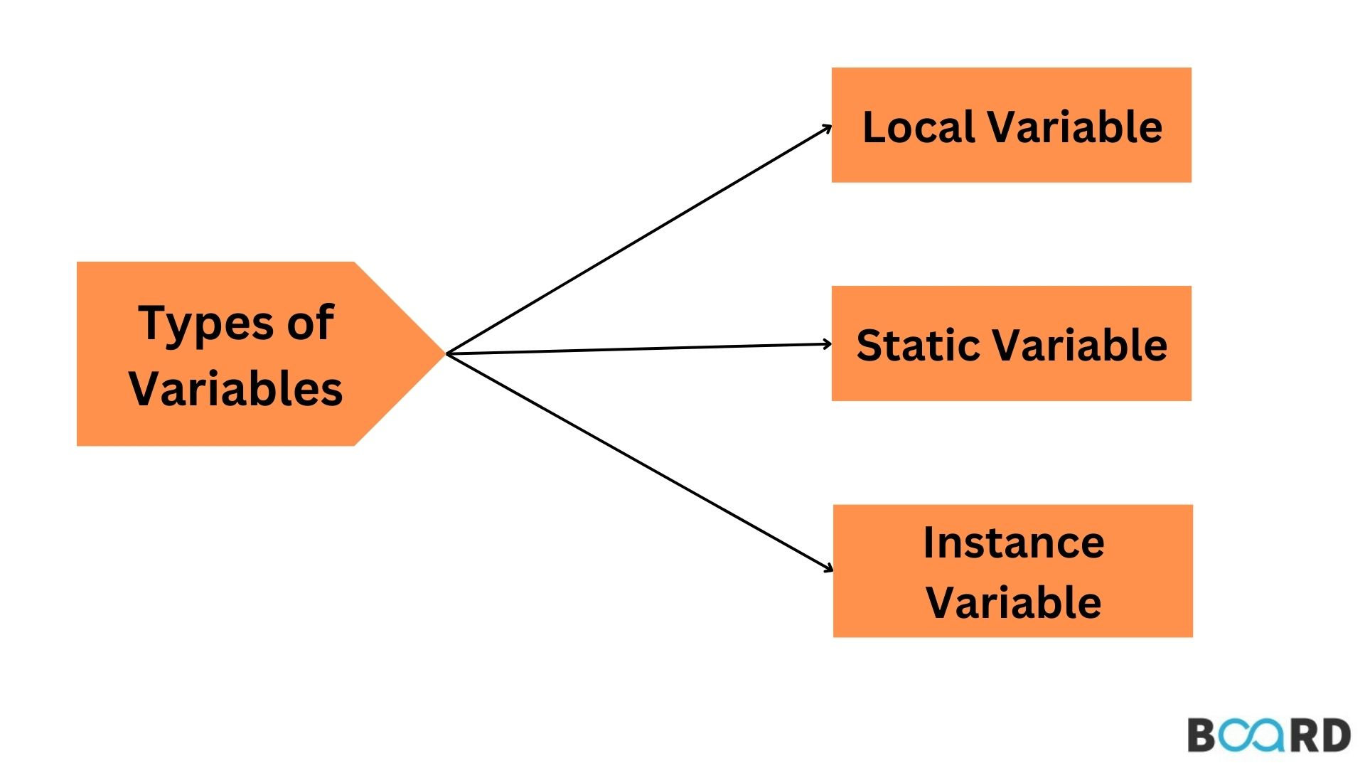
Types of variables

Slide 13
Local variables are declared in method, constructor or blocks. Local variables are initialized when method or constructor block start and will be destroyed once its end. Local variable reside in stack. Access modifiers are not used for local variables .
Instance Variables that are declared inside a class but outside any method, constructor or block. Instance variable are also variable of object commonly known as field or property,
Static are class variables declared with static keyword. Static variables are declared only once. Static variables are also used in declaring constant along with final keyword.

Slide 14
Quiz
1. Compiler translates the machine-language program into a high level-language.
True
False
A compiler translates high-level language program into a machine-language program

Slide 15
A block of code is defined with the ( ) tokens.
True
False
A block of code is defined with the { } tokens

Slide 16

What is the purpose of (;) semicolon in program?
1) Looks Fancy
2) We follow a convention
3) Java is derived from C++ ; hence we use it as it is in c++
4) To notify the compiler the end of each statement

Slide 17
Literals
Literals are data used for representing fixed values. They can be used directly in the code. For example
int a = 1;
float b = 2.5;
char c = 'F';

Slide 18
Different types of literals
1. Boolean Literals
Boolean literals are used to initialize boolean data types. They can store two values: true and false.
e.g., boolean isEmployed = true;

Slide 19
2. Integer Literals
An integer literal is a numeric value(associated with numbers) without any fractional or exponential part. There are 4 types of integer literals in Java:
Binary (base 2)
Decimal (base 10)
Octal (base 8)
Hexadecimal (base 16)
e.g.
// binary int binaryNumber = 0b10010;
// octal int octalNumber = 027;
// decimal int decNumber = 34;
// hexadecimal int hexNumber = 0x2F; // 0x represents hexadecimal
// binary int binNumber = 0b10010; // 0b represents binary
Notes:
In Java, binary starts with 0b, octal starts with 0, and hexadecimal starts with 0x.

Slide 20
3. Floating point Literals
A floating-point literal is a numeric literal that has either a fractional form or an exponential form. For example,
double myDouble = 3.4;
float myFloat = 3.4F;
// 3.445*10^2 double myDoubleScientific = 3.445e2;
Notes:
The floating-point literals are used to initialize float and double type variables.

Slide 21
4. Character Literals
Character literals are unicode character enclosed inside single quotes. For example,
char letter = 'a';

Slide 22
5. String Literals
A string literal is a sequence of characters enclosed inside double-quotes. For example,
String str1 = "Java Programming";
String str2 = “is Fun";

Slide 23
Task
public class Creator{
public static void main(String args[]){
String name = “James Gosling”;
int yearCreated = 1995;
}
}

Slide 24
In Creator.java, we have defined some variables related to James Gosling, the creator of Java.
Inside main(), use System.out.println() to print out the variable name.
Use the same command to print out yearCreated.

Slide 25
Task
Declare an integer variable named “myVariable”.
Assign integer “9” to it.
Print the variable

Slide 26
Formatting the output
To avoid any confusion for the user. We can display the output in following format.
E.g.,
System.out.println(“Age of Employee is = ”+age);
Here we use ‘+’ to join the string ”Age of Employee is = ” and the numeric variable of “age”.
The reason is that print() statement can not display more than one value. So if two values like string and a numeric value need to be displayed using a single print()method we should combine them using a ‘+’ operator.

Slide 27
Example
public class Variable{
int x,y;
x=10;
y=20;
System.out.println(x+y);
}

Slide 28
example
What will be the output of following?
public class Addition{
int x=10, y=20;
System.out.println(“Summation of two numbers = ”+ x+y);
}

Slide 29
System.out.println(“Sum of two numbers = ”);
System.out.println(x+y);
To avoid this above multiple lines and print both the lines in a single println() statement, \n is used.
e.g.,
System.out.println(“Sum of two numbers = \n”+ (x+y));
This means \n is throwing the cursor into the next line at that place. This is called backslash code or escape sequence.

Slide 30
Control sequence
A control sequence is nothing however the backslash(\) glued with a character (the character which has to be escaped) is called a control sequence.

Slide 31
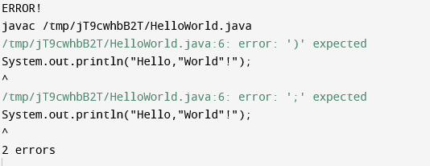
Example
System.out.println(“Hello”World”!”);
Output:

Slide 32
\\ is a control sequence used for displaying a backslash as output.
E.g.,
System.out.println(“Hello\”world/”!”);

Slide 33
Backslash codes
Backslash code | Meaning
\n | Next Line
\t | Horizontal tab space, gives a tab between two words.
\r | Enter Key, It moves the output point back to the beginning of the line without moving down a line (usually).
\b | Backspace, It moves the cursor one character back with or without deleting the character(depending upon compiler)
\f | Form feed, used to indicate page break
\\ | Displays \
\” | Displays “
\’ | Displays ‘

Slide 34
Task
Print a newline
Using System.out.println();
Print the line “Java”.
Print a new line using “\n”.
Print another line “programming”.

Slide 35
Task
Define a double variable “first” with value 68.99.
Define a float variable “second” with value 168.996 using f or F at the end.
Print “first” and “second” in separate lines.

